Slide 1
SAS Project
Krishna Parekh
MS Health Informatics

Slide 2
Introduction
A study was conducted to determine whether a “DRUG A” helps to reduce the fasting sugar level. There are 3400 patients were enrolled for this study. They were randomly assigned to one.of three treatment Groups:
Low dose Drug A
High dose Drug A
Placebo.
After ten weeks their fasting sugar levels were recorded.
There were two files:
File 1 has variables: Patient ID , Age, State, Length of stay, Total charge.
File 2 has variables: Patient ID, Group and Testscores ( FBS level).

Slide 3
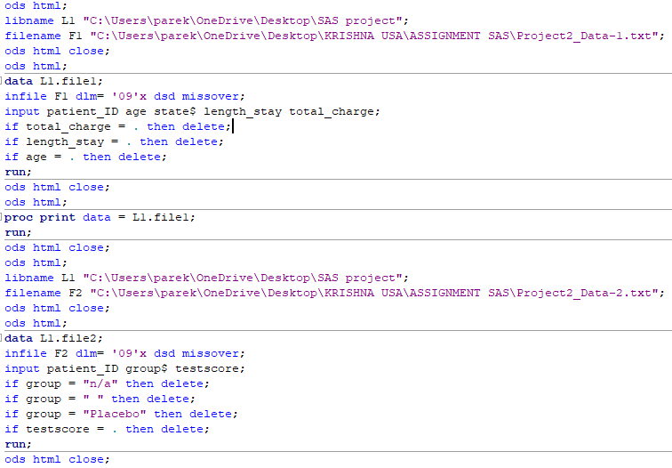
Data reading and cleaning
The missing data and n/a data was removed.
The placebo group was deleted as it was not required based on my research question.

Slide 4
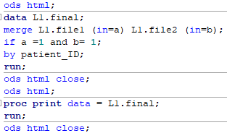
Merging
Full inner join was performed to get matching data from both the tables.

Slide 5
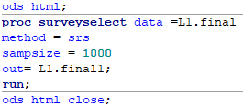
Sampling

Slide 6
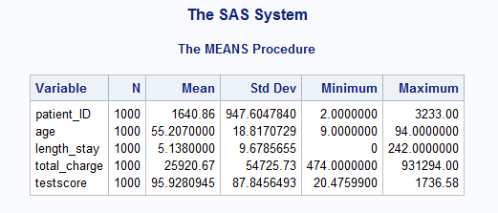
Descriptive statistics
Proc means procedure

Slide 7
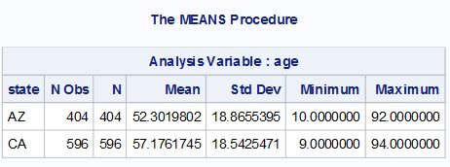
Proc means
To know the number of patients from each state: AZ and CA.
Out of 1000, There were 404 number of people chosen from Arizona and 596 from California.

Slide 8
Hypothesis
Research question: There is a difference in the testscores between the group High dose and Low dose.
Alternative Hypothesis: Mean of testscore of Highdose = Lowdose.
Null Hypothesis: There is no difference in the mean of testscore between High dose = Low dose

Slide 9
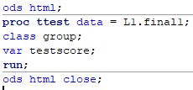
T test- Two sample
Two sample test was executed as I have 1 independent variable with two categories in Group: High and Low.

Slide 10
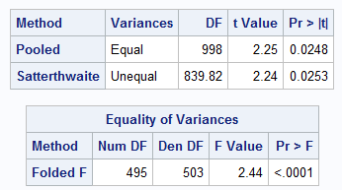
Equality of Variance
The (Equality of Variance) F value is far from 1, and the P value for equality of variance is <0.001 therefore rejecting the null hypothesis. This indicates that the variances of the two categories are not equal.
Therefore, we take the Unequal P-value (Satterthwaite).
P value = 0.0253

Slide 11
P value – 0.0253
Since the research question is a two tail hypothesis, we will not divide the p-value by 2.
The p value is less than alpha(0.05) indicating that we can reject the null hypothesis.
This shows that there is a difference between the mean of the testscores between high dose and low dose.

Slide 12
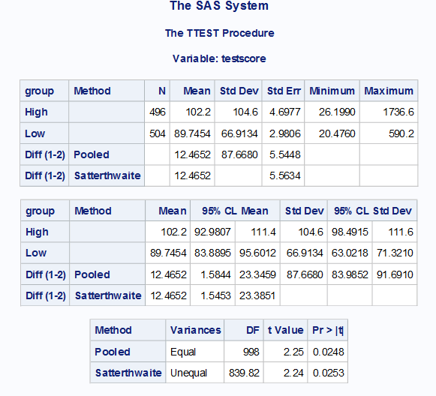
The mean for the high dose group is 102.2
The mean for low dose group is 89.74.
The mean difference is 12.46

Slide 13
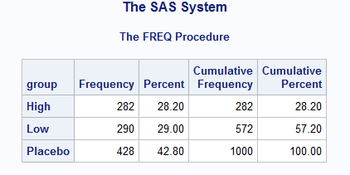
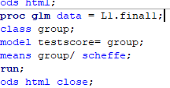
Proc GLM was executed

Slide 14
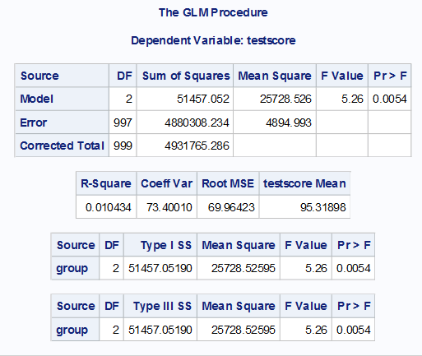
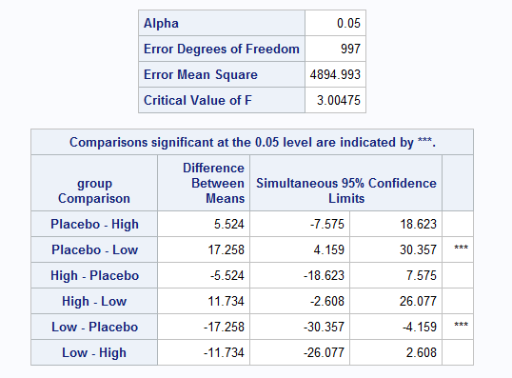
Anova test with scheffe.
With all the three groups: High, Low, Placebo.

Slide 15
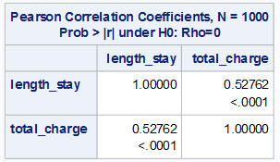
Pearson correlation
Question: To check for pearson correlation between length of stay and the total charge.
This indicates that there is a moderate positive correlation between the length of stay and the total charge. Meaning that when the length of stay increases, so does the total charge increases.

Slide 16
Conclusions
Ttest: Although the p-value is close to 0.05, it is not a significant value but we can still conclude that-
There is a difference between the low dose group and high dose group affecting the Fasting blood sugar levels.
The mean difference was found to be 12.4
Anova test: p-value is significant with 0.005 to reject the null hypothesis.
The scheffe test indicates the highest difference of means is between low and placebo group.
There is positive relationship between length of stay and total charge.
Out of 1000, 404 were from Arizona and 596 from California.

Slide 17
THANK YOU

